Slide 1
Higher Hazard Substances
Scientists, Stakeholders,Toxics Users, Government
Working together to determine higher hazard substances.
Thus far:
Methylene chloride
Formaldehyde
Hexavalent chromium
Perchloroethylene
Trichloroethylene
Cadmium and Cadmium compounds
New for 2016:
Cyanide compounds
Dimethylformamide (DMF)
n-propyl bromide (nPB)
Hydrogen fluoride

Slide 2
Do I Trip the Reporting Threshold for Hydrogen Fluoride (HF)?
Processing HF:
Dilution of 1430 pounds of 70% hydrofluoric acid to 49% hydrofluoric acid for resale would be considered processing 1,001 pounds of HF.
If 1,430 pounds of 70% hydrofluoric acid is used to manufacture fluoroboric acid, report 1,001 pounds of HF as processed

Slide 3
Do I trip a Reporting Threshold for HF?
Otherwise Use HF:
If 2043 pounds of 49% hydrofluoric acid is used in solutions to remove oxides from stainless steel, report 1001 pounds HF as otherwise used.

Slide 4
Processing or Manufacturing HF from Ammonium Bifluoride or Other Fluoride Salts:
When dry ammonium bifluoride (ABF) contacts water, it generates hydrofluoric acid. The hydrogen fluoride derived from fluoride salts (such as ABF) is considered manufactured. (EPA guidance 745-R-00-005)
Ammonium bifluoride used (processed) in dry blends for resale are not likely to have reportable quantities of HF.

Slide 5
Do I trip a Reporting Threshold for HF?
Under TURA, when a given listed substance is introduced into production anywhere at the facility, it is counted only once at the facility level, regardless of how many times that listed substance is used, recycled or reused onsite.

Slide 6
Processing or Manufacturing HF from Ammonium Bifluoride or Other Fluoride Salts:
In solution ammonium bifluoride can produce 35% of its weight as hydrogen fluoride. The other 65% as ammonium (mono)fluoride which could produce even more HF in the presence of stronger acids.

Slide 7
Chemical Machining

Slide 8
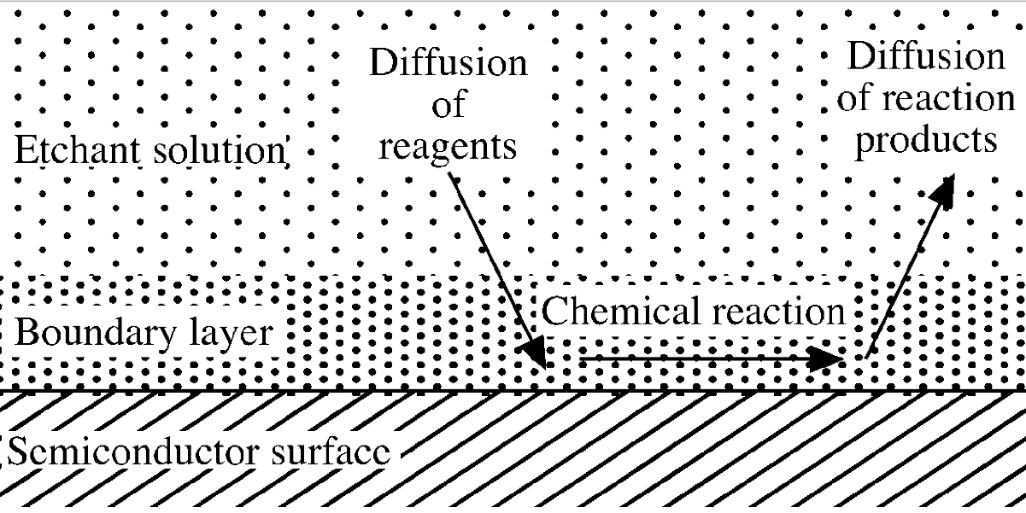
Chemical Etching

Slide 9
Hydrogen Fluoride Example
Example: In the calendar year, 3000 pounds of ammonium bifluoride is consumed in an etching bath.
Solution: 35% of 3000 pounds manufactures 1050 pounds of HF which exceeds the 1000 pound threshold. The 1050 pounds of HF manufactured is also otherwise used, however it is only reported once at the facility level, and this amount would not be added to other quantities otherwise used.

Slide 10
Form S, Section 1: 2 Hydrogen Fluoride
Manufactured = 1050 pounds
Processed =
0 pounds
E. Otherwise used = 0 pounds
F. Byproduct =
?? pounds
G. Shipped as Product= 0 pounds
Materials balance
b. Chemical was Consumed or Transformed = ? pounds

Slide 11
Do I trip a Reporting Threshold for Cyanide Compounds?
Under TURA, when a given listed substance is introduced into production anywhere at the facility, it is counted only once at the facility level, regardless of how many times that listed substance is used, recycled or reused onsite.

Slide 12
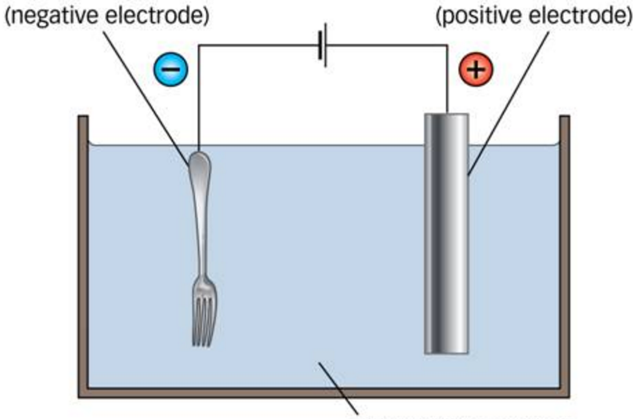
Object Being Plated
Pure Copper
60 Kg of CuCN
25 Kg
94 Kg of NaCN
NaCN
323 Kg
Cu
455 Kg
323 Kg
Cu
Cu⁺ CN ⁻
Copper Cyanide Solution

Slide 13
Cyanide Compounds Example
A 300 gallon copper plating tank operates with 1000 liters of solution. A fresh solution is made up at the beginning of the calendar year with 60 kilograms of copper cyanide and 94 kilograms of sodium cyanide.
Over the course of the year, 323 kilograms of copper are consumed from the anode, creating 455 kg of copper cyanide as 323 kilograms of copper are plated from the solution onto steel parts.
Also, 25 kg of cyanide salts have been added to maintain tank concentrations due to dragout losses.

Slide 14
Cyanide Compounds Example
At the end of the year the plating bath has accumulated contaminants and needs replacement.
Byproduct cyanide compounds = 179 kg x 2.20 = 394 lbs.
NOTE: Atomic Weight of Copper is 63.546 and
Molecular Weight of Cuprous Cyanide is 89.563.
Molecular weight of Sodium Cyanide is 49.007
Other complexes in solution may dominate
such as Sodium Copper Cyanide MW = 138.570

Slide 15
Object Being Plated
Pure Copper
60 Kg of CuCN
25 Kg
94 Kg of NaCN
NaCN
323 Kg
Cu
455 Kg
323 Kg
Cu
Cu⁺ CN ⁻
Copper Cyanide Solution

Slide 16
Cyanide Compounds Solution
In that case: Form S, Section 1: Facility-Wide Use of Listed Chemical (Cyanide Compounds)
c. Manufactured = 455 kg X (2.20 lb/kg) = 1001 pounds of Copper Cyanide
d. Processed = 60 kg X (2.20 lb/kg) = 132 pounds of Copper Cyanide
e. Otherwise used = (94 kg + 25 kg) = 119 kg x (2.20 lb/kg) = 262 pounds of Sodium Cyanide
f. Byproduct = 179 kg X (2.20 lb/kg) = 394 pounds CuCN and NaCN
g. Shipped as Product = 0 kg = 0 pounds
Form S, Section 2: Materials Balance
b. Chemical was Consumed or Transformed = XX pounds of Copper Cyanide

Slide 17
Form S, Section 1: 2 Cyanide Compounds Category
Manufactured = 1001 pounds
Processed =
132 pounds
E. Otherwise used = 262 pounds
F. Byproduct =
394 pounds
G. Shipped as Product= 0 pounds
Materials balance
b. Chemical was Consumed or Transformed = XX pounds

